Slide 1
Object-Oriented Fundamentals
CSCI 4448/5448: Object-Oriented Analysis & Design
Lecture 5

Slide 2
Acknowledgement & Materials Copyright
I’d like to start by acknowledging Dr. Ken Anderson
Ken is a Professor and the Chair of the Department of Computer Science
Ken taught OOAD on several occasions, and has graciously allowed me to use his copyrighted material for this instance of the class
Although I will modify the materials to update and personalize this class, the original materials this class is based on are all copyrighted © Kenneth M. Anderson; the materials are used with his consent; and this use in no way challenges his copyright

Slide 3
Learning Objectives
Review key object-oriented concepts
(Some repetition, but we’ll stop with OO basics here)

Slide 4
Overview of OO Fundamentals
Delegation
HAS-A
Revisit Inheritance
IS-A
Revisit Polymorphism
message passing
polymorphic arguments and return types
Interfaces
Abstract Classes
Object Identity

Slide 5
Delegation
When designing a class, there are four ways to handle an incoming message
Handle message by implementing code in a method
Let the class’s superclass handle the request via inheritance
Pass the request to another object (delegation)
some combination of the previous three
Delegation is employed when some other class already exists to handle a request that might be made on the class being designed
The host class simply creates a private instance of the helper class and sends messages to it when appropriate
As such, delegation is often referred to as a “HAS-A” relationship
A Car object HAS-A Engine object

Slide 6
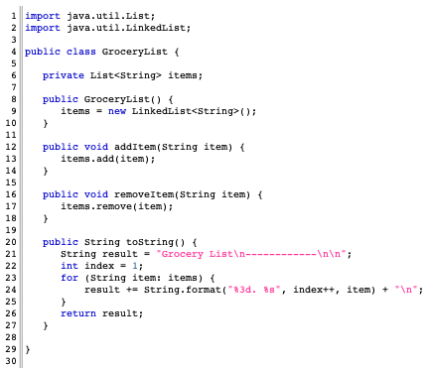
GroceryList delegates all of its work to Java’s LinkedList class (which it accesses via the List interface).

Slide 7
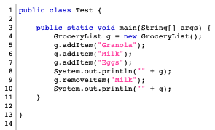
With the delegation, I get a nice abstraction in my client code. I can create grocery lists, add and remove items and get a printout of the current state of the list.

Slide 8
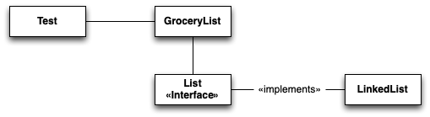
UML for GroceryList with Delegation
GroceryList needs “list like” functionality. So, internally, it uses a LinkedList (via a List interface). This is hidden from Test which just sees a “grocery list” with a nice abstraction.
Example of a UML Class Diagram. Full UML review coming soon…

Slide 9

UML for GroceryList with no Delegation
Test needs “grocery list” functionality which the Developer decides is “close enough” to “list like” functionality. Test simply makes use of a List directly, even though the names of the List class (it’s methods, class name, attributes, etc.) do not provide a good abstraction for “grocery list”

Slide 10
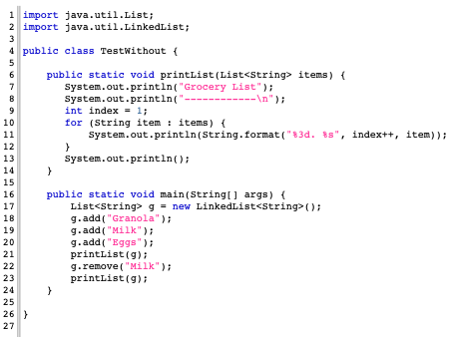
Without delegation, I get less abstraction. I’m using the List interface directly with its method names and I have to create a static method to handle the printing of the list rather than using toString().

Slide 11
Delegation (II)
Now, the two programs (with delegation and without delegation) produce exactly the same output
So, do we care which method we use?
Yes!
(But see the blog “programming in the twenty-first century” for a counterpoint to this answer: “An app needs to work and be relatively stable and bug free, but there are many ways to reach that point.”)
Benefits of Delegation
Better abstraction
Less code in classes we write ourselves
We can change delegation relationships at runtime!
Unlike inheritance relationships
Imagine if we had created GroceryList as a subclass of LinkedList – Not Good!
Why? Because GroceryList IS-NOT-A LinkedList

Slide 12
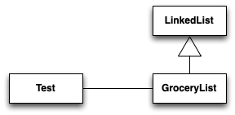
UML for GroceryList with Inheritance
In this hypothetical version of GroceryList, inheritance would pin us down in ways that are unpleasant; we would be unable to hide LinkedList’s public API from Test; those methods would be visible to Test, even if GroceryList added it’s own methods.
Plus, we would be unable to switch the data structure used by GroceryList at run time, if that ever became needed

Slide 13
Delegation (III)
Changing delegation relationships at run-time
A class can use a set at run-time
Set<String> items = new HashSet<String>();
If the class suddenly needs to be sorted, it can do this
items = new TreeSet<String>(items);
We have changed the delegation to an entirely new object at run-time and now the items are sorted
In both cases, the type of items is Set<String> and we get the correct behavior via polymorphism
Summary
Don’t re-invent the wheel… delegate!
Delegation is dynamic (not static)
delegation relationships can change at run-time
Not tied to inheritance
indeed, considered much more flexible; In languages that support only single inheritance this is important!

Slide 14
Inheritance (I)
Inheritance is a mechanism for sharing (public/protected) features between classes
Subclasses have an “IS-A” relationship with their superclass
A Hippo IS-A Animal makes sense while the reverse does not
IS-A relationships are transitive
If D is a subclass of C and C is a subclass of B, then D IS-A B is true
Good OO design strives to make sure that all IS-A relationships in a software system “make sense”
Consider Dog IS-A Canine vs. Dog IS-A Window
The latter might actually be tried by an inexperienced designer who wants to display each Dog object in its own separate window
This is known as implementation inheritance; it is considered poor design and something to be avoided

Slide 15
Inheritance (II)
Inheritance enables significant code reuse since subclasses gain access to the code defined in their ancestors
The next two slides show two ways of creating a set of classes modeling various types of Animals
The first uses no inheritance and likely contains a lot of duplicated code
The second uses inheritance and requires less code
even though it has more classes than the former

Slide 16
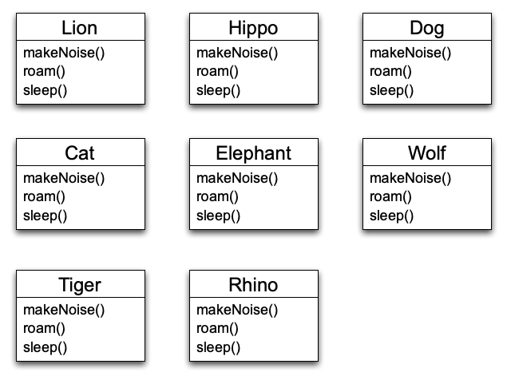
Animals (No Inheritance)

Slide 17
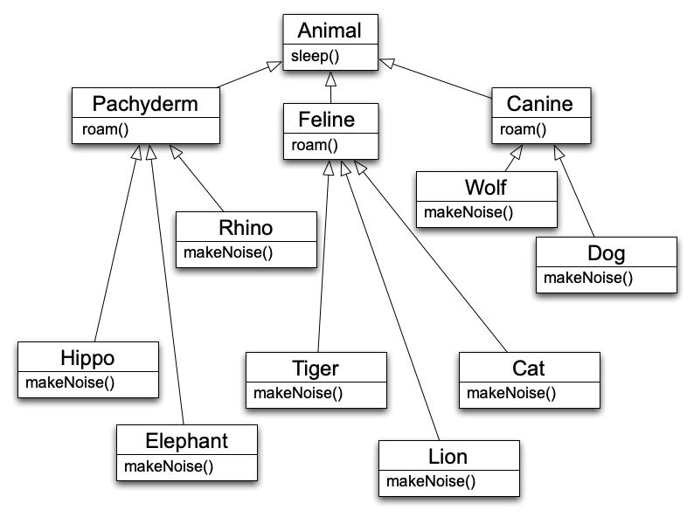
Animals (With Inheritance)
In coding these two examples:
without inheritance: 9 files, 200 lines of code
with inheritance: 13 files, 167 lines of code
approximately a 15% savings, even for this simple example

Slide 18
Inheritance (III)
An important aspect of inheritance is substitutability
Since a subclass exhibits all of the behavior of its superclass, it can be used anywhere an instance of its superclass is used
The textbook describes this as polymorphism
Furthermore, subclasses can add additional behaviors that make sense for it and override behaviors provided by the superclass, altering them to suit its needs
This is both powerful AND dangerous
Why? Stay tuned…

Slide 19
Polymorphism (I)
OO programming languages support polymorphism (“many forms”)
In practice, this allows code
to be written with respect to the root of an inheritance hierarchy
and function correctly when applied to the root’s subclasses
Message Passing vs. Method Invocation
With polymorphism, a message ostensibly sent to a superclass, may be handled by a subclass
Compare this
Animal a = new Animal();
a.sleep(); // sleep() in Animal called
with this
Animal a = new Lion();
a.sleep(); // sleep() in Lion called

Slide 20
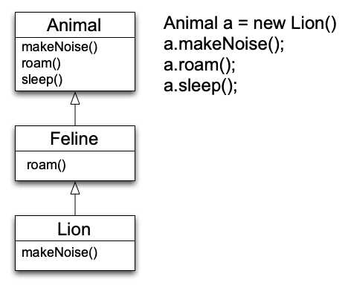
Polymorphism Example
Without polymorphism, the code on the right only calls methods in Animal
Think C++ non-virtual method invocations
With polymorphism
a.roam() invokes Feline.roam()
a.makeNoise() invokes Lion.makeNoise()
A message sent to Animal travels down the hierarchy looking for the “most specific” method body
In actuality, method lookup starts with Lion and goes up

Slide 21
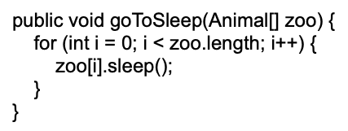
Why is this important?
Polymorphism allows us to write very abstract code that is robust with respect to the creation of new subclasses
For instance

Slide 22
Importance (I)
In the previous code
we don’t care what type of animals are contained in the array
we just call sleep() and get the correct behavior for each type of animal
Indeed, if a new subclass of animal is created
the above code still functions correctly AND
it doesn’t need to be recompiled
with dynamic class loading, if the above code was running in a server, you wouldn’t even need to “stop the server”; you could simply load a new subclass and “keep on trucking”
It only cares about Animal, not its subclasses
as long as Animal doesn’t change, the addition/removal of Animal subclasses has no impact

Slide 23
Importance (II)
We can view a class’s public methods as establishing a contract that it and its subclasses promise to keep
if we code to the (root) contract, as we did in the previous example, we can create very robust and easy to maintain software systems
This perspective is known as design by contract
Earlier, we referred to method overloading as “powerful AND dangerous”
The danger comes from the possibility that a subclass may change the behavior of a method such that it no longer follows the contract established by a superclass
such a change will break previously abstract and robust code

Slide 24
Importance (III)
Consider what would happen if an Animal subclass overrides the sleep() method to make its instances flee from a predator or eat a meal
Our goToSleep() method would no longer succeed in putting all of the Zoo’s animals to sleep
If we could not change the offending subclass, we would have to modify the goToSleep() method to contain special case code to handle it
this would break abstraction and seriously degrade the maintainability of that code

Slide 25
Implicit vs. Explicit Design By Contract
When we talk about Design by Contract here, we’re talking about respecting the schema put in place by the public methods and class/subclass designs in the OO program
This is an implied or implicit contract, we have not forced compliance
Compare this with the explicit Design by Contract found in an OO language like Eiffel, where the specification for a routine can be explicitly written in code
set_second (s: INTEGER)
-- Set the second from `s'.
require
valid_argument_for_second: 0 <= s and s <= 59
ensure
second_set: second = s
end
https://www.eiffel.org/doc/solutions/Design_by_Contract_and_Assertions
Libraries are available for other languages (like Java and Python) to allow explicit Design by Contract specification
See JML (the Java Modeling Language) or PyContract as examples
https://wiki.c2.com/?DesignByContract

Slide 26
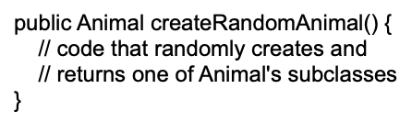
Polymorphism (II)
Finally, polymorphism is supported in arguments to methods and method return types
In our goToSleep() method, we passed in a polymorphic argument, namely an array of Animals
The code doesn’t care if the array contains Animal instances or any of its subclasses
In addition, we can create methods that return polymorphic return values. For example:
When using the createRandomAnimal() method, we don’t know ahead of time which instance of an Animal subclass will be returned
That’s okay as long as we are happy to interact with it via the API provided by the Animal superclass

Slide 27
Override vs. Overload
Override – run time polymorphism
Normally what we mean by polymorphic methods
The superclass has a method with a certain signature
The subclass declares the same method and same signature, but with different behavior
Overload – compile time polymorphism
The class in question may have two methods of the same name with different signatures and different behavior
Common for constructors, for instance
We can call whichever version by providing the appropriate arguments
Some languages (like Python and C++) allow Operator Overloading
The standard operators, like + for instance, can be overloaded in Python by providing an alternate definition for the __add__ function
Java examples: https://www.javatpoint.com/method-overloading-vs-method-overriding-in-java

Slide 28
Abstract Classes
There are times when you want to make the “design by contract” principle more explicit
Abstract classes and Interfaces let you do this
An abstract class is simply one which cannot be directly instantiated
It is designed from the start to be subclassed
It does this by declaring a number of method signatures without providing method implementations for them
this sets a contract that each subclass must meet
Abstract classes are useful since
they allow you to provide code for some methods (enabling code reuse)
while still defining an abstract interface that subclasses must implement

Slide 29
Interfaces
Interfaces go one step further and only allow the declaration of abstract methods
you cannot provide method implementations for any of the methods declared by an interface (in the interface itself)
Er… it’s a little complicated in Java, but this is the traditional OO interface definition
Interfaces are useful when you want to define a role in your software system that could be played by any number of classes
Consider modifying the Animal hierarchy to provide operations related to pets (e.g. play() or takeForWalk())
We have several options, all with pros and cons
add Pet-related methods to Animal
add abstract Pet methods to Animal
add Pet methods only in the classes they belong (no explicit contract)
make a separate Pet superclass and have pets inherit from both Pet and Animal
make a Pet interface and have only pets implement it
This often makes the most sense although it hinders code reuse
Variation: create Pet interface, but then create Pet helper class that is then composed internally and pets delegate if they want the default behavior

Slide 30
Object Identity
In OO programming languages, all objects have a unique id
This id might be its memory location or a unique integer assigned to it when it was created
This id is used to enable a comparison of two variables to see if they point at the same object
See example next slide

Slide 31
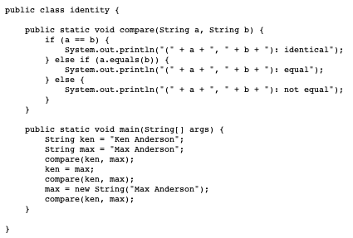
Same object
Same contents
Not Equal
Identical
Equal

Slide 32
Identity in OO A&D
Identity is also important in analysis and design
We do not want to create a class for objects that do not have unique identity in our problem domain
Consider people in an elevator
Does the elevator care who pushes its buttons?
Consider a cargo tracking application
Does the system need to monitor every carrot that exists inside a bag? How about each bag of carrots in a crate?
Consider a flight between Denver and Chicago
What uniquely identifies that flight? The plane? The flight number? The cities?
When doing analysis, you will confront similar issues
you will be searching for uniquely identifiable objects that help you solve your problem

Slide 33
Summary
Be comfortable with the OO concepts and terminology
Delegation – Has-A
Inheritance – Is-A
Polymorphism
Override vs. Overload
Design by Contract
Abstract classes and Interfaces
Identity

Slide 34
Next Steps
All staff now providing office hours:
Office hours are posted in Canvas Announcements and Piazza posts
Latest
All class assignments and dates are loaded on Canvas
Examples of graduate and semester projects posted…
No class Monday 9/5 – CU holiday
Assignments
New participation discussion topic is up on Piazza, please respond – don’t get behind on these – try to respond every week! It is 100 points of your grade…
Project 1 is up on Canvas – individual work!
Part 1 (essay questions) is due this week – Wed 8/31
Part 2 (code submission) is due next week – Wed 9/7
We’ll talk about Project 2, the first team programming project on Wed 9/7
The first Quiz is up, due Thur 9/1; Quiz 2 will go up on 9/3
Graduate Research Project team topics are due on 9/16
Stay Engaged
Make sure you sign up for Piazza and Canvas notifications
Make sure you can access the Head First Design Patterns textbook – no readings yet
Consider tutorials/resources for Git and Java especially, if you need them
Coming up
Next up: the tools – Java, Git/Markdown/Github, UML, Python
Please come find us for any help you need or questions you have!

